Slide 1
Project DECServer
An Asynchronous Autograding Server with Simulation
Irshad Khan | 23m0824
Suchit Meshram | 23m0814

Slide 2
Overall coding choices
C++
We began the project using C till version 3 . However, as we progressed, we recognized that C++ significantly has better string handling and STL Libraries(eg Maps ,Queues used in version 4). Because of this c++ become our preferred choice.

Slide 3
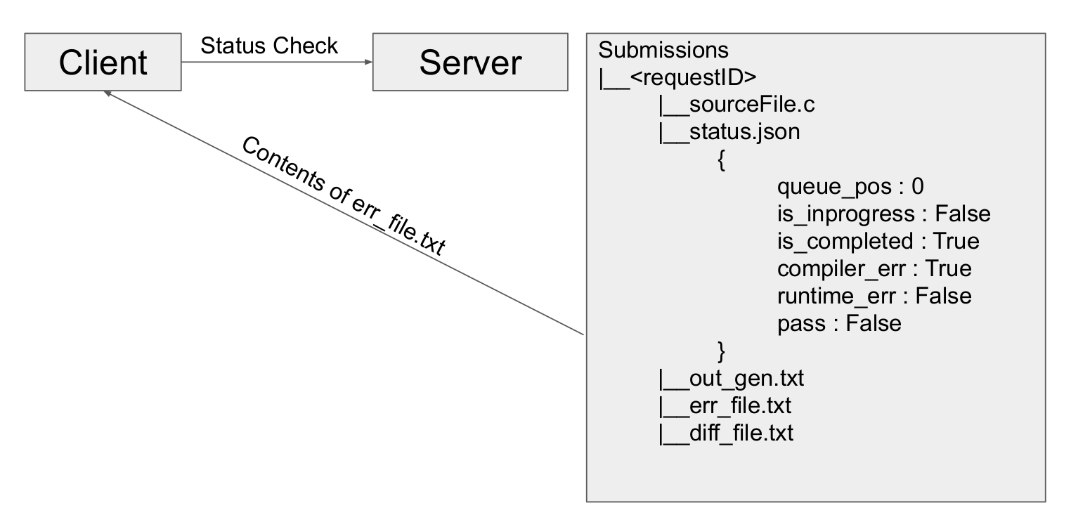
Asynchronous application design

Slide 4
Design choices
RequestId(Token) Was generated using Timestamp + thread_id to get unique.
Unbounded Queue was used to store client request.We stored Token in the queue before return response token to client.
Map was used to store status fields in status.txt .Where status .txt is present in directory same as token.
Results of particular client is stored in ./Submissions/<token_id>/*
When client checks for status along with its token ,status.txt fields are checked and based on that correct output files content is send to client .
Currently Server is not resilient to reboots ,client needs to submit requests again

Slide 5
Performance Analysis
During this analysis we have kept the parameters as follows.
Load Testing starts from 1 → 100 clients
Number of loops: 10
Sleep Time: 1sec
Threads :4

Slide 6
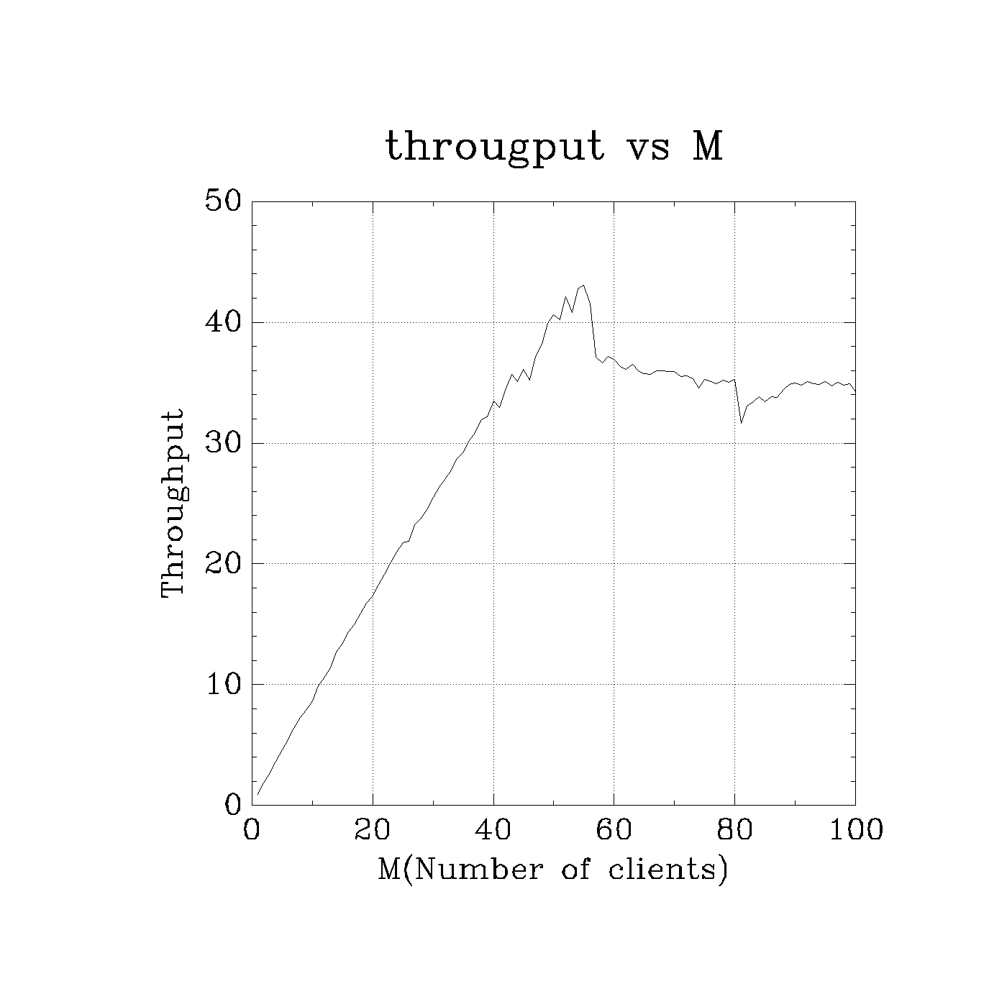
Throughput/ Goodput
For 4 cores and 4 threads ,with each request taking around 100ms we achieve around 40 request/sec.

Slide 7
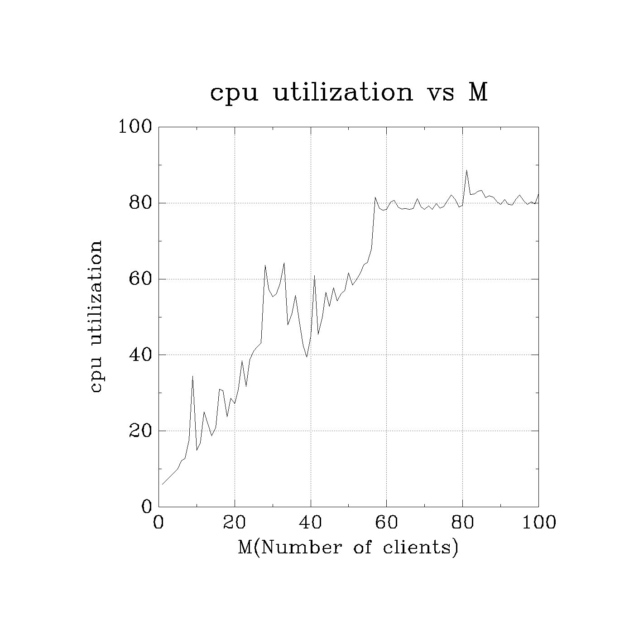
Average CPU Utilization
As Number of clients increases,cpu utilization increases.

Slide 8
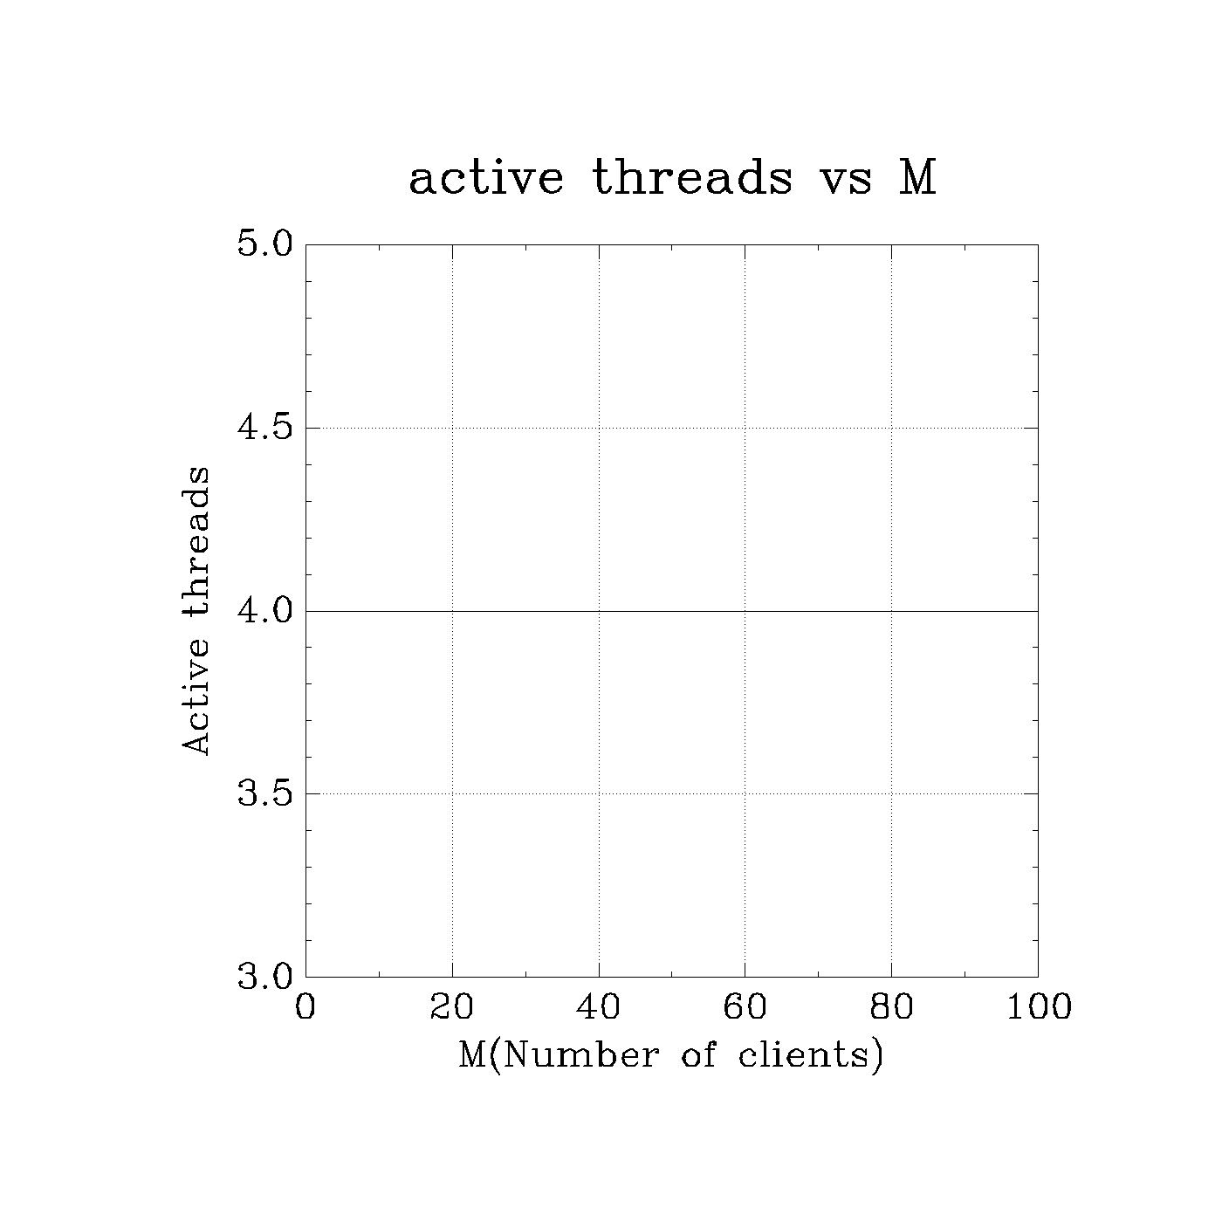
Average Number of Threads
We have thread pool of size 4

Slide 9
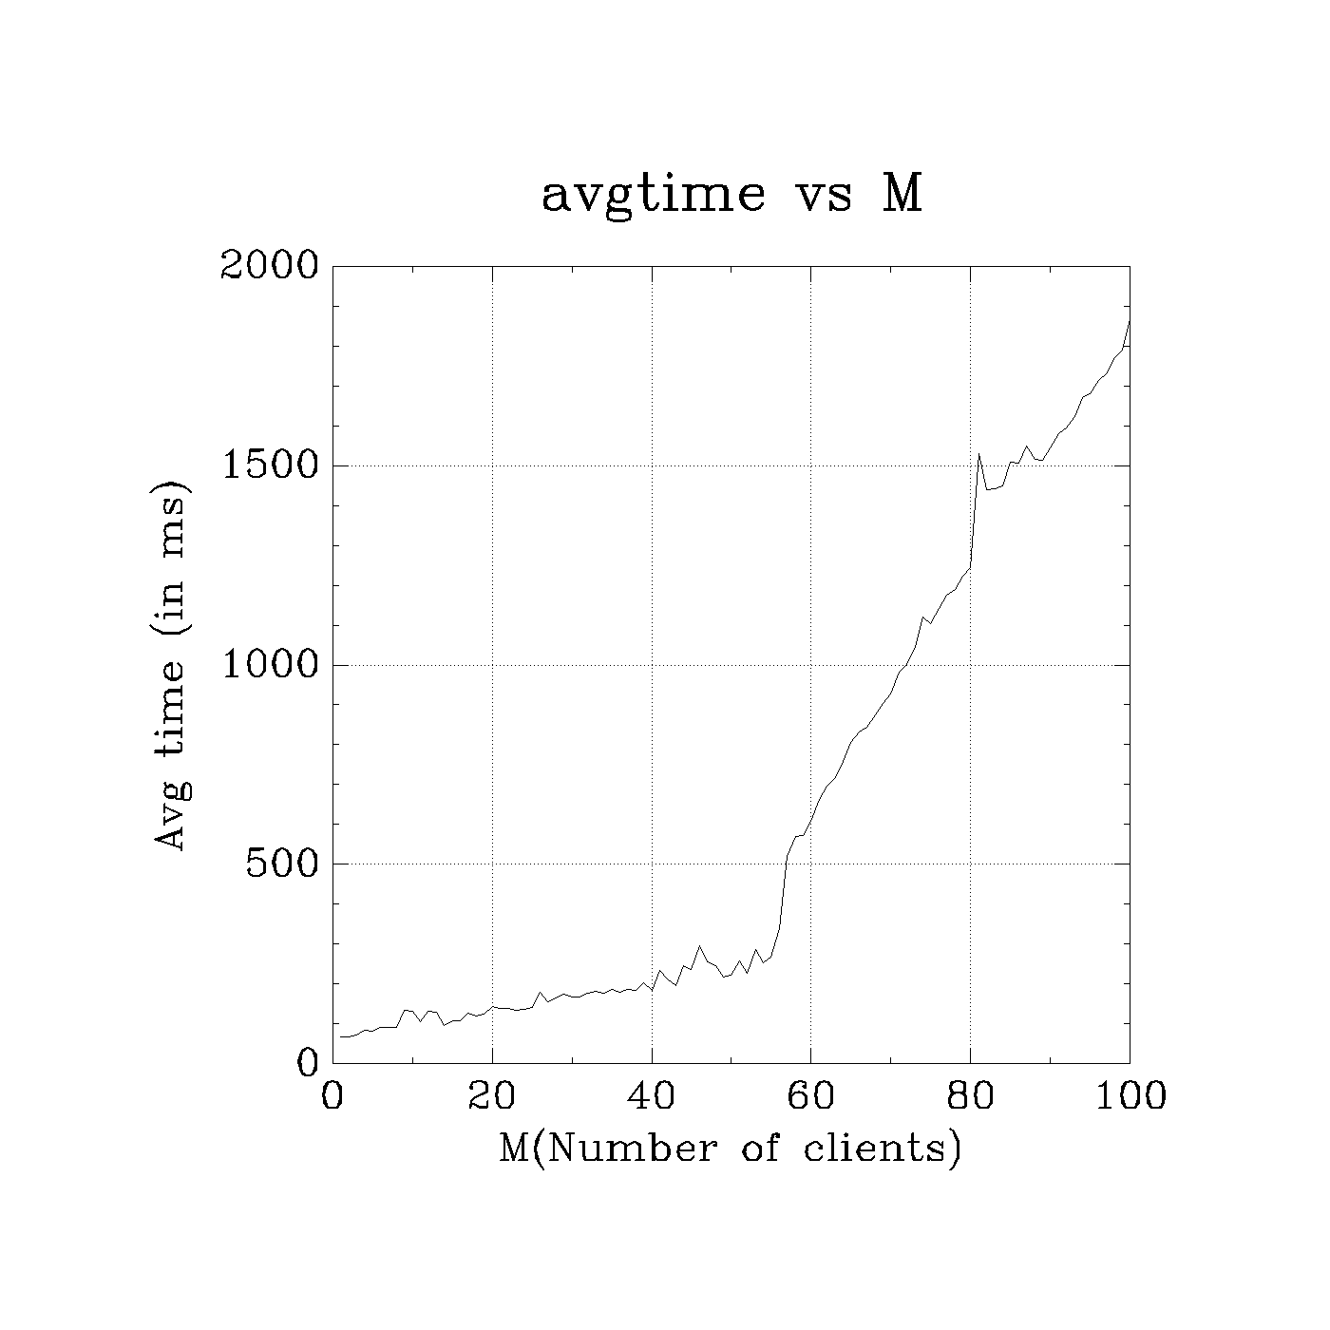
Average Response Time taken
As the number of clients increases time taken to process clients also increases.

